Slide 1

PROJECT REPORT ON
“NOTES MAKING APP”
Submitted in partial fulfillment of the requirement for the award of the degree Bachelor of Computer Applications (BCA)
SESSION: 2020-2023
Project Guided By: | Submitted By:
Under the Guidance of: Mr. Shivam Gupta Sir HOD, Impetus Institute of Professional Education, Bhopal (BCA Faculty) | Name of Student: Satyam Singh Enrollment No. AW147242013 Study Institute code No. 7242 Name of Student: Nizamuddin Enrollment No. AW147242007 Study Institute code No. 7242
Submitted to
Makhanlal Chaturvedi National University of Journalism and Communication, Bhopal Impetus Institute of Professional Education

Slide 2
Objectives-
1. Create a user- friendly notes making application that can be easily used by anyone.
2. Allow users to create, edit and manage notes.
3. Continuously improve the app based on user feedback and suggestions to enhance user experience and functionality.

Slide 3
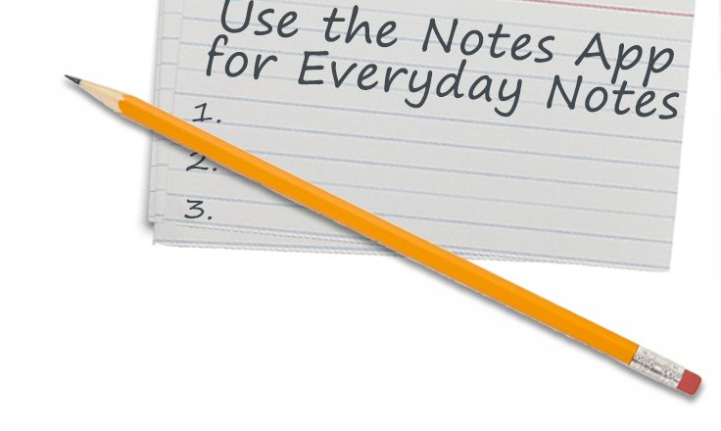
Introduction-
Welcome to the Notes Making App Project! This project aims to create a user-friendly applications that will help you organize your notes efficiently. With this app, you can easily create, edit and manage notes of all kinds – whether it’s for personal or professional use.
This project aims to provide a comprehensive notes making app that can improve productivity and organization for users. With this app, you can keep all your notes in one place and access them whenever and wherever you need them.

Slide 4
Hardware Requirements:
Processor: minimum core i3; recommended core i5 or more.
Memory (RAM): minimum 4GB; recommended 8GB or more.
Ethernet connection or a wireless adapter.
Software Requirements:
1.Operating System: operating system such as Windows, Mac, Linux.
2.Integrated Development Environment (IDE): IDE can be used for development such as Android Studio.

Slide 5
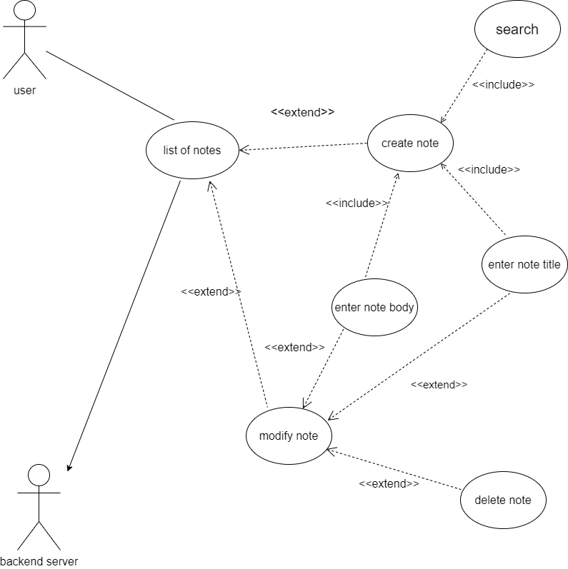
Use Case Diagram:

Slide 6
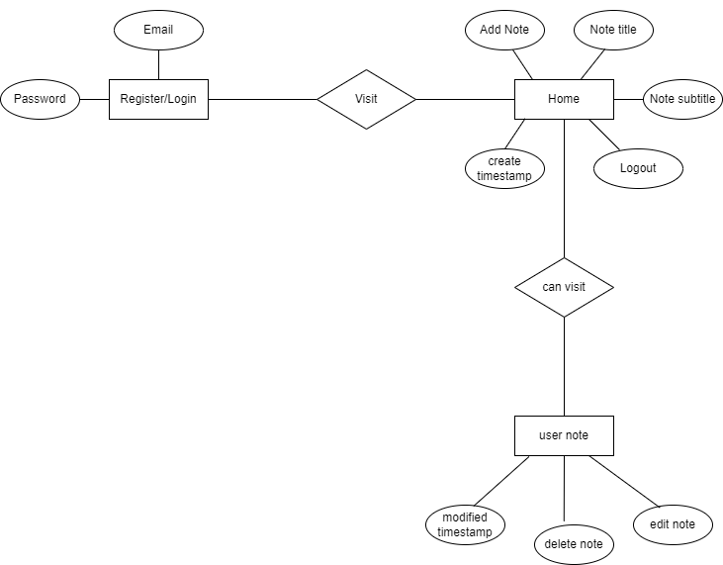
ER Diagram:
search

Slide 7
Application Flowchart:

Slide 8

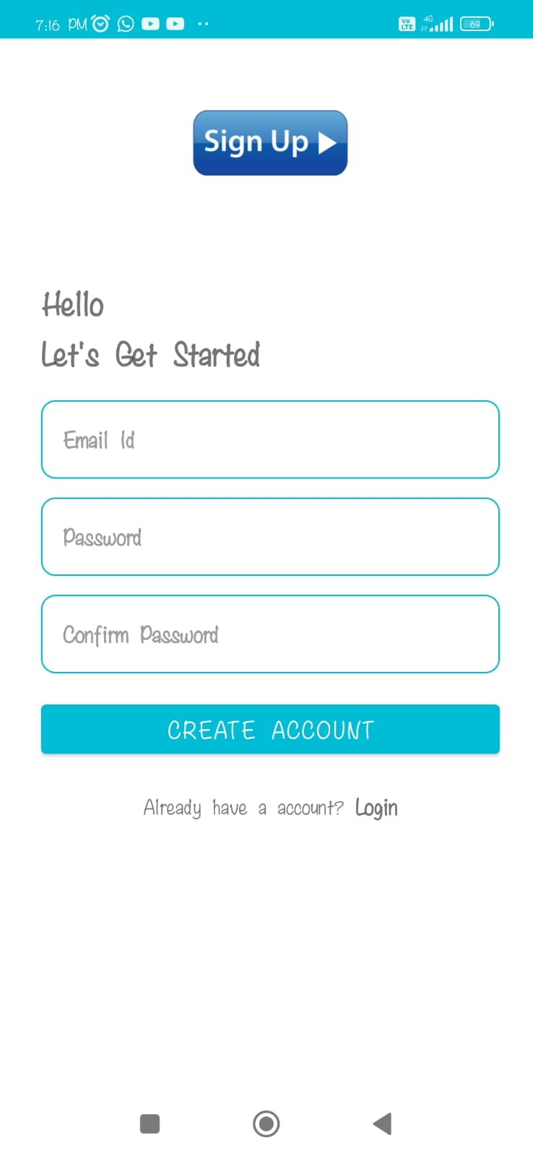
Screenshots-
Splash screen
Sign up page

Slide 9
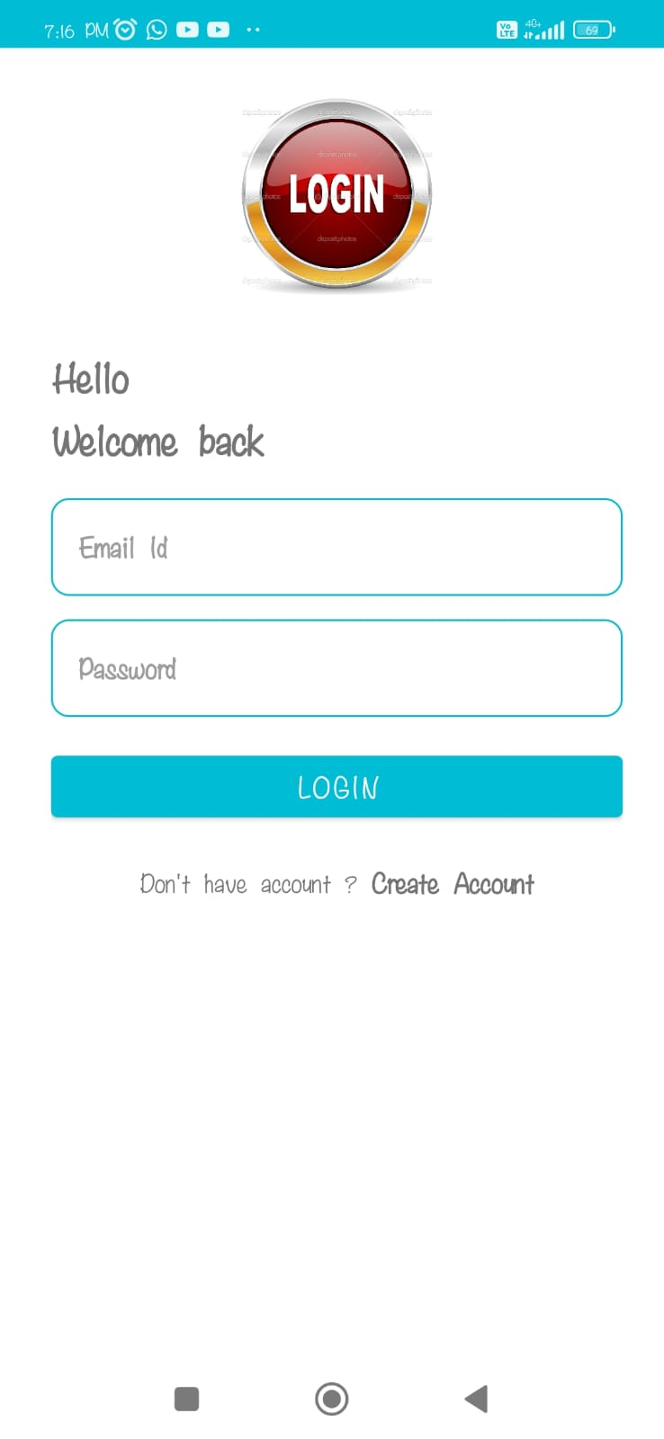

Login page
Home page

Slide 10
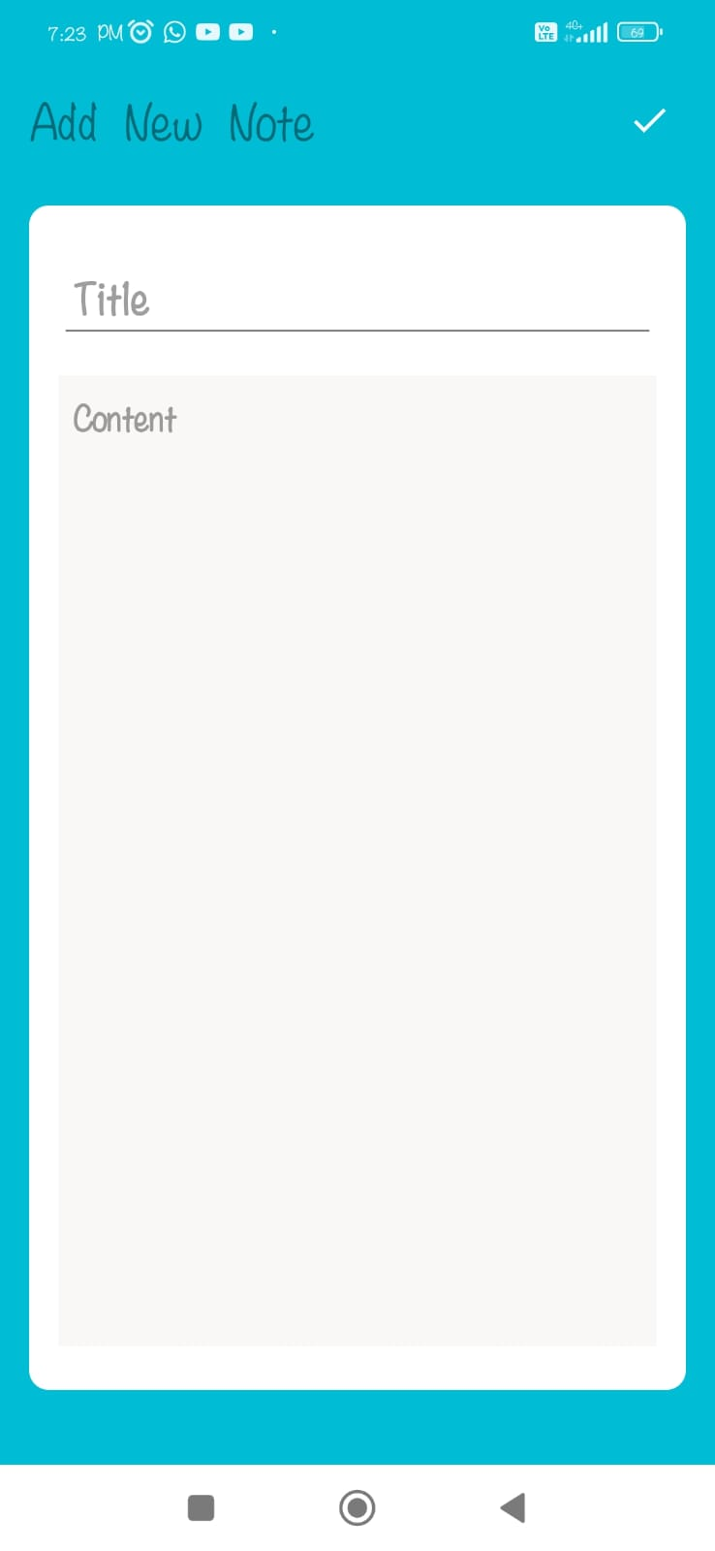
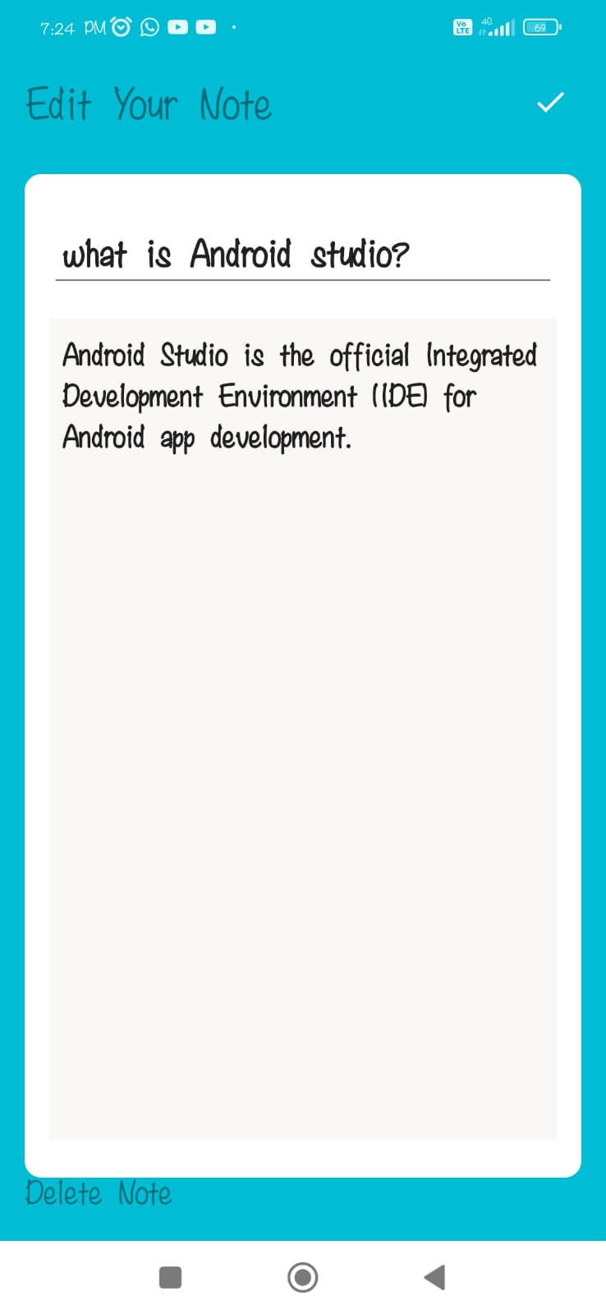
Add notes
Edit note or Delete note

Slide 11
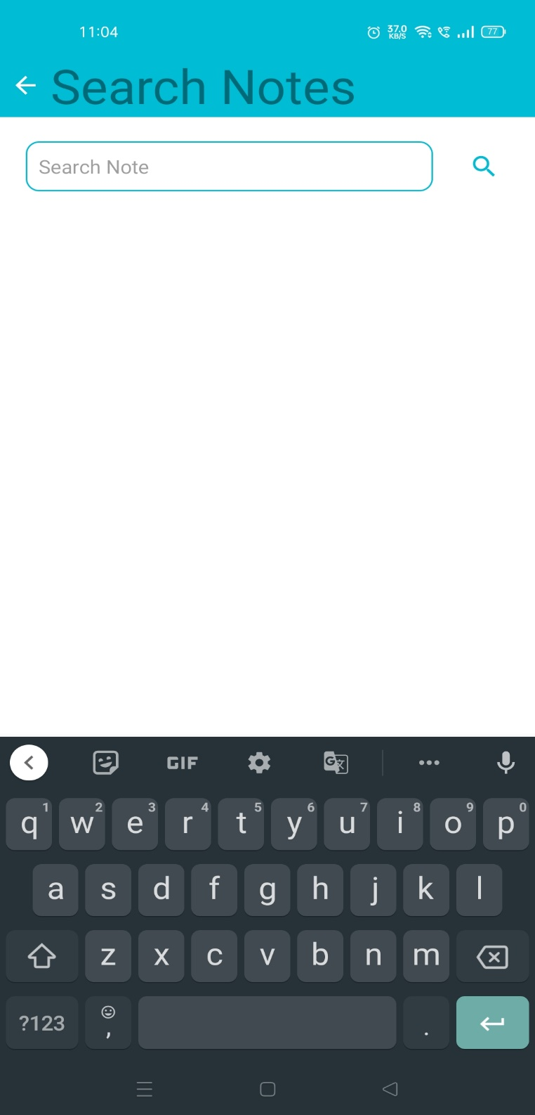
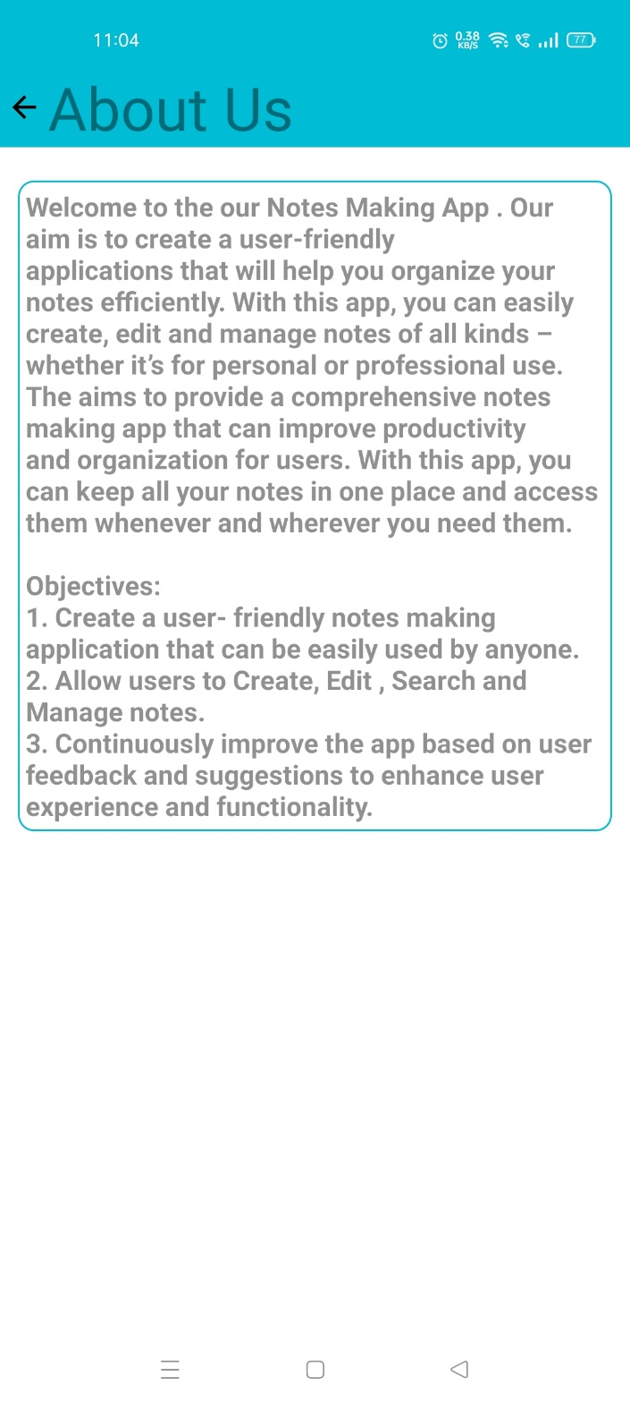
Search Notes
About Us Page

Slide 12
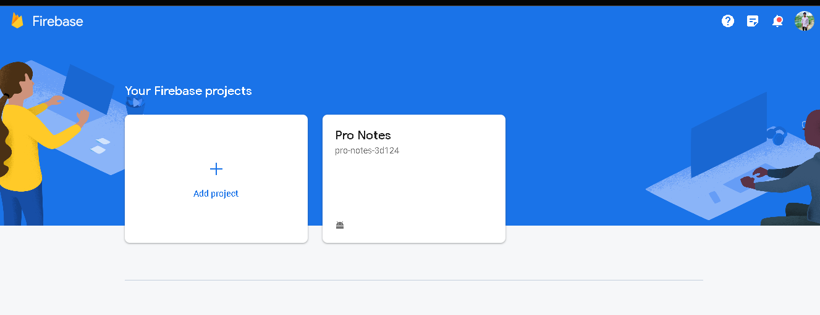
Database

Slide 13
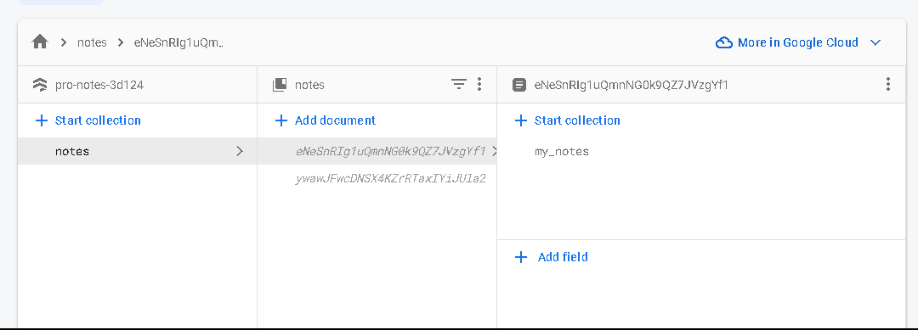

Slide 14
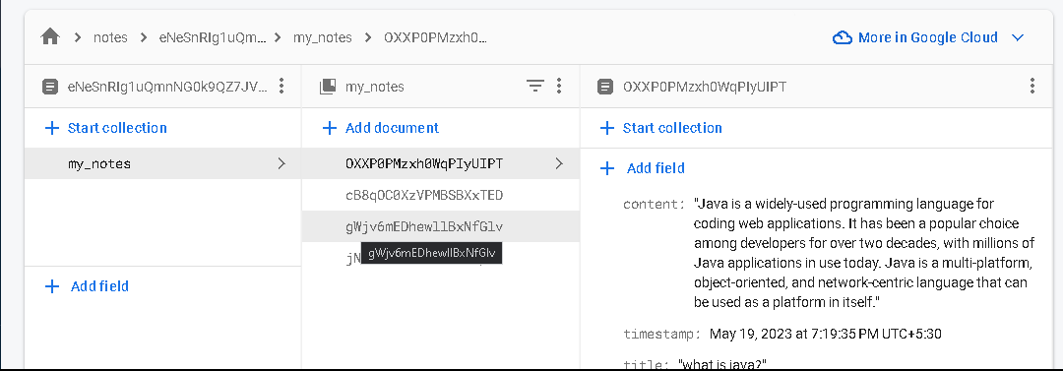

Slide 15
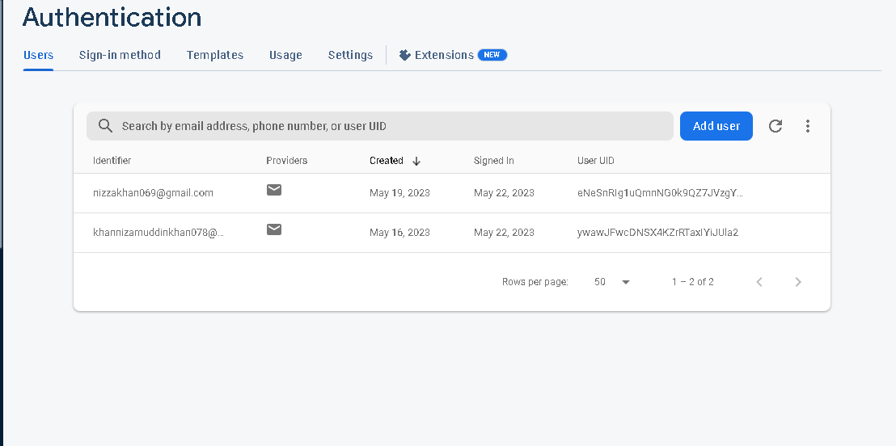

Slide 16
Conclusion
The Notes app project has been successful in meeting its goals of providing users with a simple and efficient platform for creating, organizing, and managing their notes. The app offers a user-friendly interface, with a variety of customization options.
The project faced some challenges along the way, such as ensuring data security and implementing proper backup mechanisms to prevent data loss. However, these challenges were addressed through the integration of advanced security measures and backup systems.
Overall, the Notes app project has been successful in delivering a user-friendly application that fulfills its intended purpose of providing a convenient and efficient platform for managing notes. The app has the potential to continue to evolve and improve as new features and enhancements are added in the future.

Slide 17
Future scope and further enhancement of the project
Collaboration features: Consider adding collaboration features to notes app to allow users to share notes with others and work on them together. This could include real-time editing, commenting, and version control.
Smart search and organization: Consider adding smart search and organization features to notes app, such as natural language processing (NLP) and machine learning (ML) algorithms. This could help users find and organize their notes more easily.
Voice-to-text and speech recognition: Consider adding voice-to-text and speech recognition features to notes app. This could allow users to dictate their notes instead of typing them out, making the app more accessible and convenient.
Cross-platform compatibility: Ensure that notes app is compatible with different platforms and devices, such as desktops, laptops, tablets, and smartphones. This could involve developing separate versions of the app for each platform, or using cross-platform development frameworks like React Native or Xamarin.
Security and privacy: Ensure that notes app is secure and protects users' privacy. This could involve implementing strong encryption, two-factor authentication, and other security features to prevent unauthorized access to users' notes.
Analytics and feedback: Use analytics and feedback mechanisms to monitor how users are using notes app, and to identify areas for improvement. This could involve collecting usage data, conducting user surveys, and implementing user feedback mechanisms within the app itself.

Slide 18
Bibliography/references
https://developer.android.com/docs
https://firebaseopensource.com/projects/firebase/firebaseui-android/
implementation 'com.firebaseui:firebase-ui-database:8.0.2'

